Slide 1
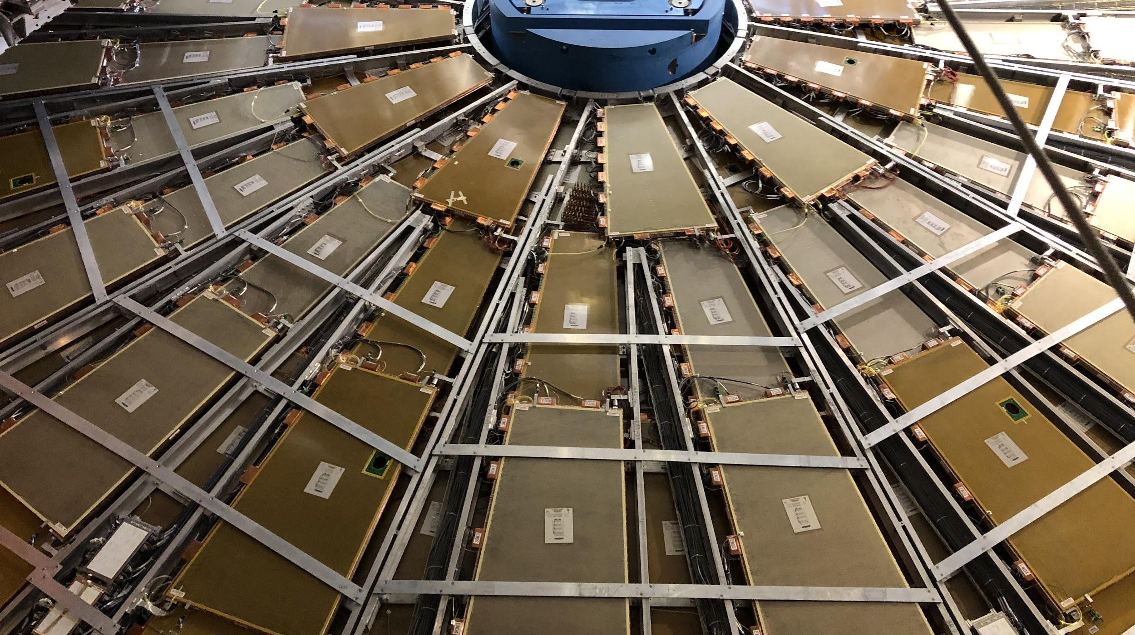

Maintenance Weekly
TileCal Op Meeting, 28 October 2021
Irakli Minashvili, Chris Thomas, Dawit Belayneh, Katie Hughes

Slide 2
Update
Dawit and Katie are in isolation after being exposed to a COVID positive individual, we should return early next week.
Chris located 21 extra valves that can be assembled
Still 37 short to complete EBA
On the week of Nov. 8 we get access to the cavern again, and we will work on connecting the pneumatic pipes on EBC and installing valves on EBA.

